Slide 1
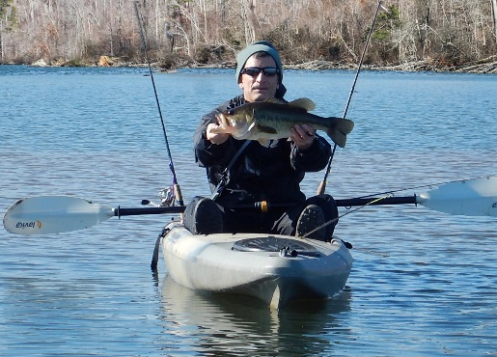
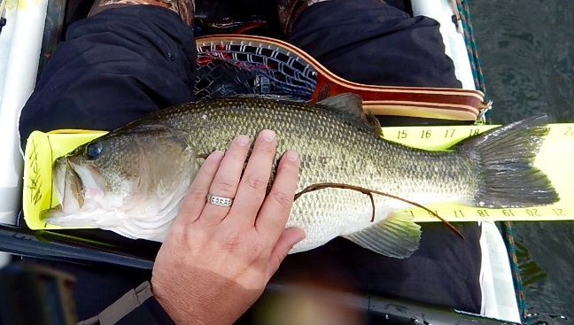
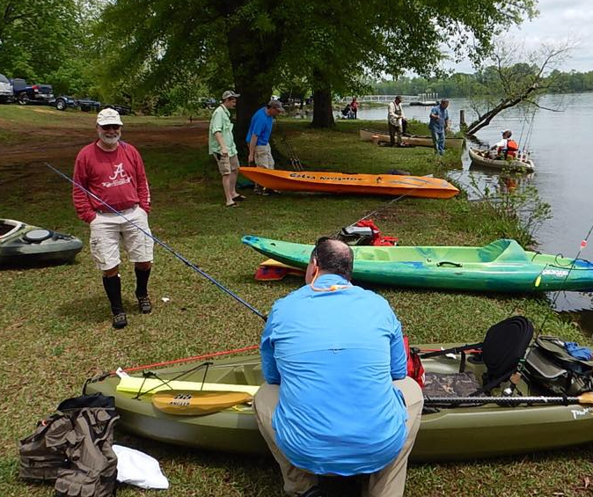
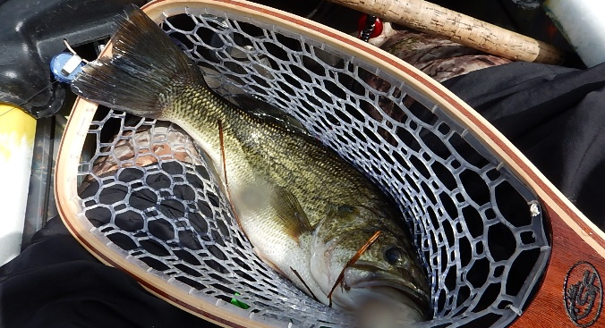
TVC-AAAA 2022 Bob Vlasics Classic “Kayak Bass Division” Kayak Fishing Tournament
Held In Concert With AAAA Bass Tournament (Big Bass Boats/Teams)
7th Annual Event!
100% Payout!
Low Impact, Primitive Fishing at It’s BEST!
ENTRY FEE: per one person kayak $30 (100% Payout and number of places determined by number of entrants)
$200 Big Fish Pot sponsored by Yulista!!! REGISTER NLT: 5 March 2022
Photo Record of captured Fish on a Hawg Trough (provided) is Required. (total length of best 5 fish determines your score)
LAUNCH TIME: Safe light (about 0530) …water & sandwich provided.
SCHEDULE: Fish at First Light – Kayaks Out of Water by 2:00p.m. … Join Others at Jackson County Park at 2:00p.m. to submit your catch. AWARDS CEREMONY Starts at 3 PM… Fishing Results, Food, Beverages and Door Prizes!!!
Interested in joining AAAA? visit: www.tvc-aaaa.com or www.quad-a.org
WHEN:
WHERE:
POCs:
12 March 2022
Jackson County Park,
Scottsboro, AL
Brett Bonnell 256/777-0404
Riley Jacobs 256/929-3917
Mitch Delk 256/755-0730
2017 Joseph Circle Huntsville, AL 35811
Entry Fee Checks Pay To:

Slide 2
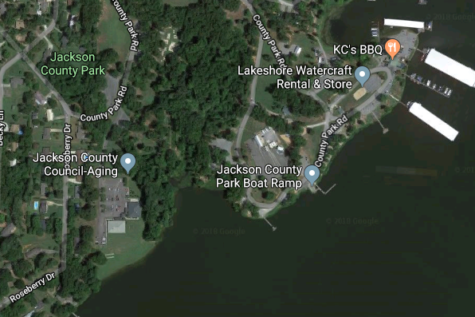
TVC-AAAA 2022 Vlasics Classic Kayak Fishing Tournament (12 March 2022) Registration Form
Launch Site
HWY 431
Registration must be completed NLT – 5 March 2022
Registration Fee: $30.00 Per Person (No 2 Person Boats)
*** Make Checks Payable to Mitch Delk ***
Outdoor Social Distancing Guidelines will be followed for this event
Name: _______________________________________ AAAA Member: □ Yes □ No
Email Address: ___________________________________________________
Phone: Work: _______________ Home: _________________ Cell: ________________
A Waiver must be signed at Jackson County Park Prior to Launch/Fishing.
(This space for Tournament Committee Use only)
Entry Fee Paid: □ Yes □ No Date Paid: _______________ Check #: _______________
BOAT #: ___________

