Slide 1
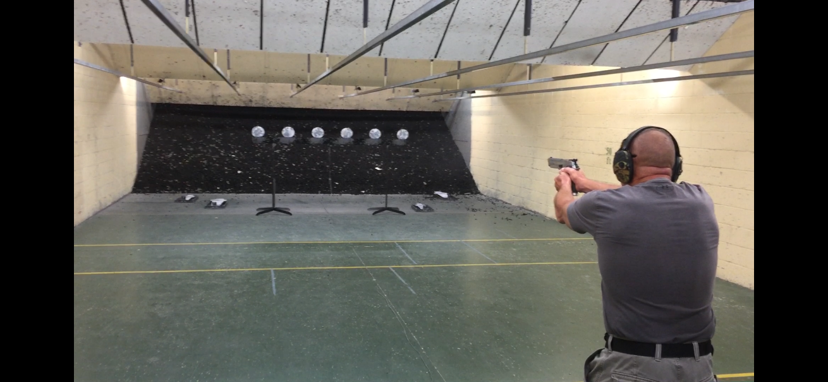
The Tennessee Valley Chapter of the
Army Aviation Association of America
Is Hosting the 4th Annual
March 6th at Last Resort Guns in Madison
4:00 – 6:00 p.m.
Registration at the Last Resort Website
https://lastresort.wildapricot.org/event-3698914
Pre-Registration cost is $25 for AAAA/LRGI members - Registration on the day and for all others $35, $100 for all Team Entries (4 person team)
The shooting will be at 11yrds at Steel Plate Racks with 6 plates to knock down.
Each contestant will get 2 attempts for a best time.
Shooting will be divided up into 2 classes for individual and team event
Race Gun/Optic and Service Pistol
Definition Race Gun and Optic: Any handgun that has been Tuned Modified or built for Competitive shooting with or without an optical sight.
Definition Service Pistol: Any Handgun as issued to Police or Military. A mass produced pistol unmodified from standard, Iron Sights only.
(for all details visit the registration link above )
You must sign up and pay for the event to reserve your space!
Pizza and Beer after the event!
POC – Steve Sanders 256-313-8481

